Slide 1


Cédric Berthomieu
04.03.2024

Slide 2

Outline
Executive Summary
Introduction
Methodology
Results
Conclusion
Appendix

Slide 3
Executive Summary
Summary of methodologies
Data collection & Wrangling
EDA with Data Visualisation and SQL
Interactive map with Folium
Interactive dashboard with Plotly Dash
Predictive Analysis
Summary of all results
Aggregated results from
EDA Visualisation and SQL
Interactive map and dashboard findings
Predictive Analysis

Slide 4
Introduction
Project background and context
From a customer point of view, it’s important to increase as much as possible the ratio of success during a launch. To minimize costs, it’s also important to reuse first stage rocket.
Problems you want to find answers
We want to predict the mission outcome depending on several factors, including launch site, rocket used, payload,….

Slide 5

Section 1

Slide 6
Methodology
Executive Summary
Data collection methodology:
SpaceX REST API – launch sites, rocket used, payload, specifications, landing outcomes.
Webscraping – Falcon 9 launch datas
Perform data wrangling
Converted landed outcome to usable class (0/1)
Perform exploratory data analysis (EDA) using visualization and SQL
Perform interactive visual analytics using Folium and Plotly Dash
Perform predictive analysis using classification models
After preprocessing, splitting train and test sets, trained various models to find best hyperparameters on Linear Regression, SVM, KNN, Decision Tree. Compared conf.Matrix

Slide 7
Data Collection
Describe how data sets were collected.
You need to present your data collection process use key phrases and flowcharts

Slide 8


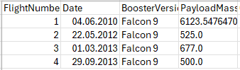
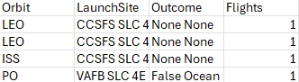
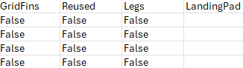
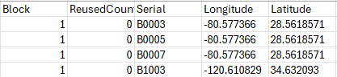
Data Collection – SpaceX API
Present your data collection with SpaceX REST calls using key phrases and flowcharts
Add the GitHub URL of the completed SpaceX API calls notebook (must include completed code cell and outcome cell), as an external reference and peer-review purpose
Github URL: GitHub data Collection
API
Launches
Rockets
LaunchSite
PayLoad
Core
Load all past launches
dataset_part_1.csv
Replace booster with rocket API names
Replace Launch pad with launch Site API names
Replace Payloads with Payload API mass and orbit
Replace cores with the cores API giving outcome, landing type, landing pad…

Slide 9
Data Collection - Scraping
Present your web scraping process using key phrases and flowcharts
Add the GitHub URL of the completed web scraping notebook, as an external reference and peer-review purpose
Github URL: GitHub data Scraping
Webpage
Wikipedia
Parse it
Extract Launches
Create new dataframe
Save it in CSV
Read page
Spacex_web_scraped.csv
With BeautifulSoup
From tables

Slide 10
Data Wrangling
Describe how data were processed
Landing outcomes has to be converted to Classes (either 0 or 1).
0 is a bad outcome, that is, the booster did not land.
1 is a good outcome, that is, the booster did land.
Github URL: GitHub data wrangling
Read CSV
Create Class column (from Outcome & bad outcomes list)
Save CSV file dataset_part_2.csv with new column

Slide 11
EDA with Data Visualization
First analysis was done with graphical analysis on various topics:
- Plotted some characteristics to check if they are linked to the outcome.
> Flight number / Payload
> Flight number / Launch site
> Payload / Launch site
- Bar chart on
> Success rate / orbit type
- Relation FlightNumber / Orbit Type with plots
- Relation Payload / Orbit Type with plots
- Launch success yearly trend
GitHub: EDA Viz

Slide 12
EDA with SQL
Displayed number of launches per Launch Site
First 5 records for launch sites starting with ‘CCA’
Computed the total mass of booster launched for customer NASA(CRS)
Displayed average total mass for booster “F9 v1.1”
List the date when the first succesful landing outcome in ground pad was acheived.
Names of the boosters which have success in drone ship and have payload mass greater than 4000 but less than 6000
Total number of successful and failure mission outcomes
Names of the booster_versions which have carried the maximum payload mass.
For each month in 2015, display mission outcome, booster, launch site
Rank the count of landing outcomes (such as Failure (drone ship) or Success (ground pad)) between the date 2010-06-04 and 2017-03-20, in descending order.
GitHub: EDA SQL

Slide 13
Build an Interactive Map with Folium
Launch Sites and JSC have been added to the map, with a circle, and a marker
Each launch has then been added, with a clear green/red marker showing result.
We can then visually identify potential outcome for each launch site, and also the best one.
Drawn lines with the coast along with a marker to identify distance with objects.
Drawn lines with railroad, highway and closest city to we can answer to some questions about distance with those objects.
GitHub: Launch Site Location

Slide 14
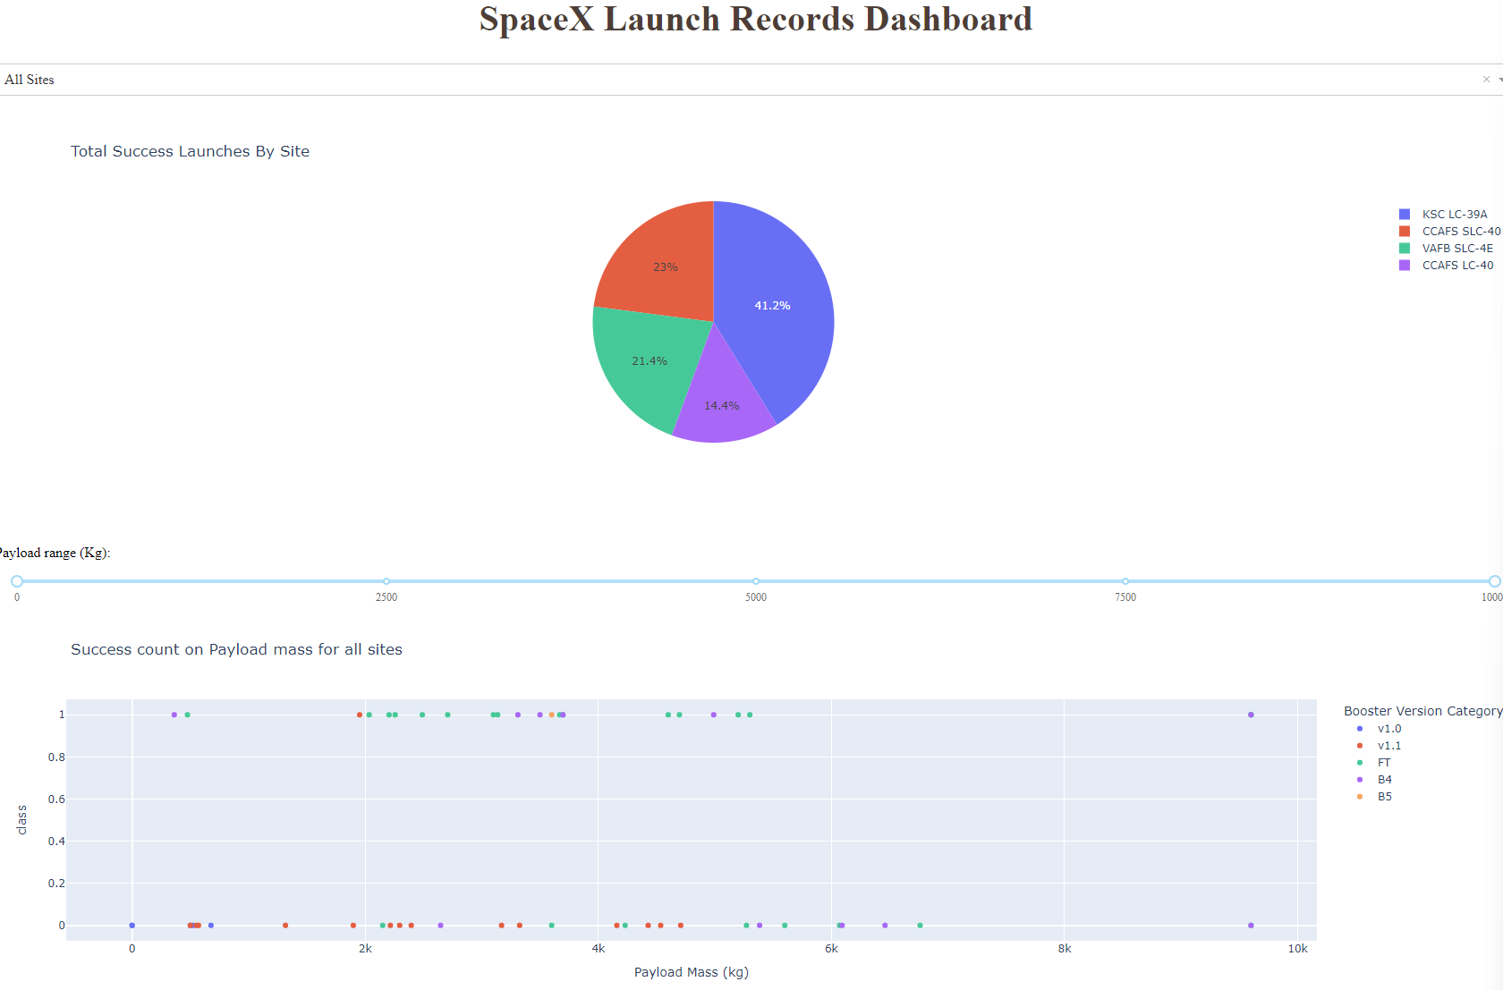
Build a Dashboard with Plotly Dash
A dropdown allowing to select a specific launch site, or all of them, and a slider allowing to select some payloads were added for investigation purposes.
A pie chart was added to show the % of success
Payload mass vs Outcome, colored by the
Booster version allows us to understand their link.
GitHub URL: Plotly

Slide 15
Predictive Analysis (Classification)
After loading our data, we’ve normalized in data to made them comparable.
We’ve split them into test and training sets.
Created following models, trained them, tested and compared their confusion matrix and accuracy
Linear Regression
KNN
SVM
Decision Tree
To identify the best result, the confusion matrix helped us identify good results. Then accuracy on training and test sets were used to answer to the question
GitHub URL: Machine Learning

Slide 16
Results
Exploratory data analysis results
Interactive analytics demo in screenshots
Predictive analysis results

Slide 17

Section 2

Slide 18
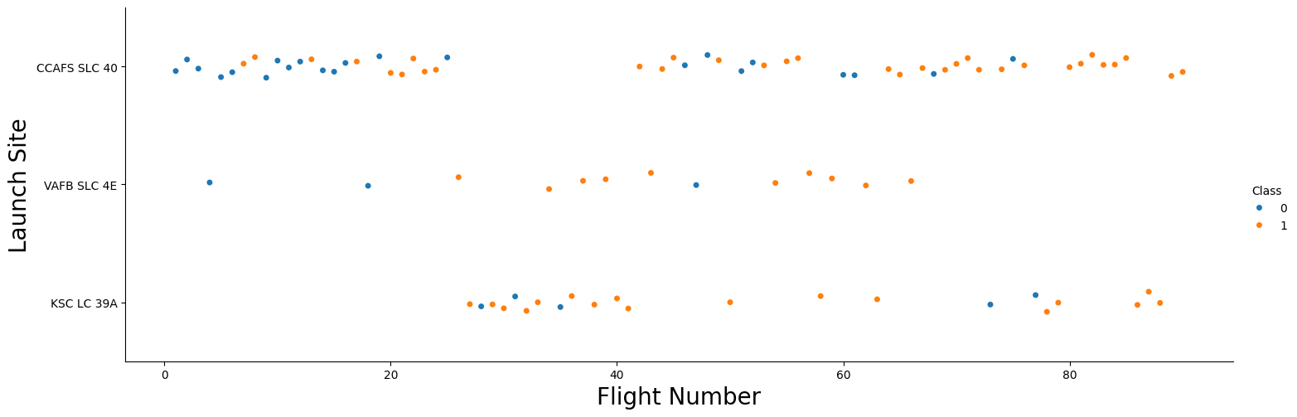
Flight Number vs. Launch Site
Smaller Flight Numbers on VAFB+CCAFS leads to more failure
Bigger flight numbers on VAFB+CCAFS leads to more success
No such link with KSC which seems unrelated

Slide 19
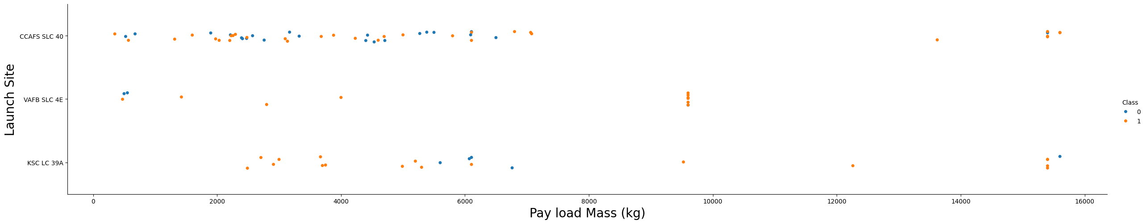
Payload vs. Launch Site
VAFB does not launch any rocket above 9800 kg

Slide 20
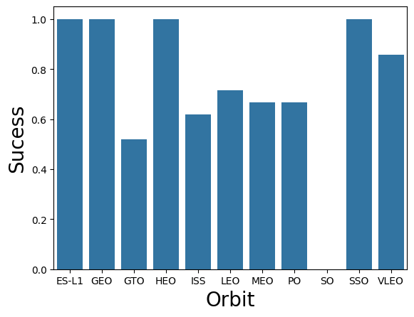
Success Rate vs. Orbit Type
ES-L1, GEO, HEO and SSO have the highest success rate

Slide 21
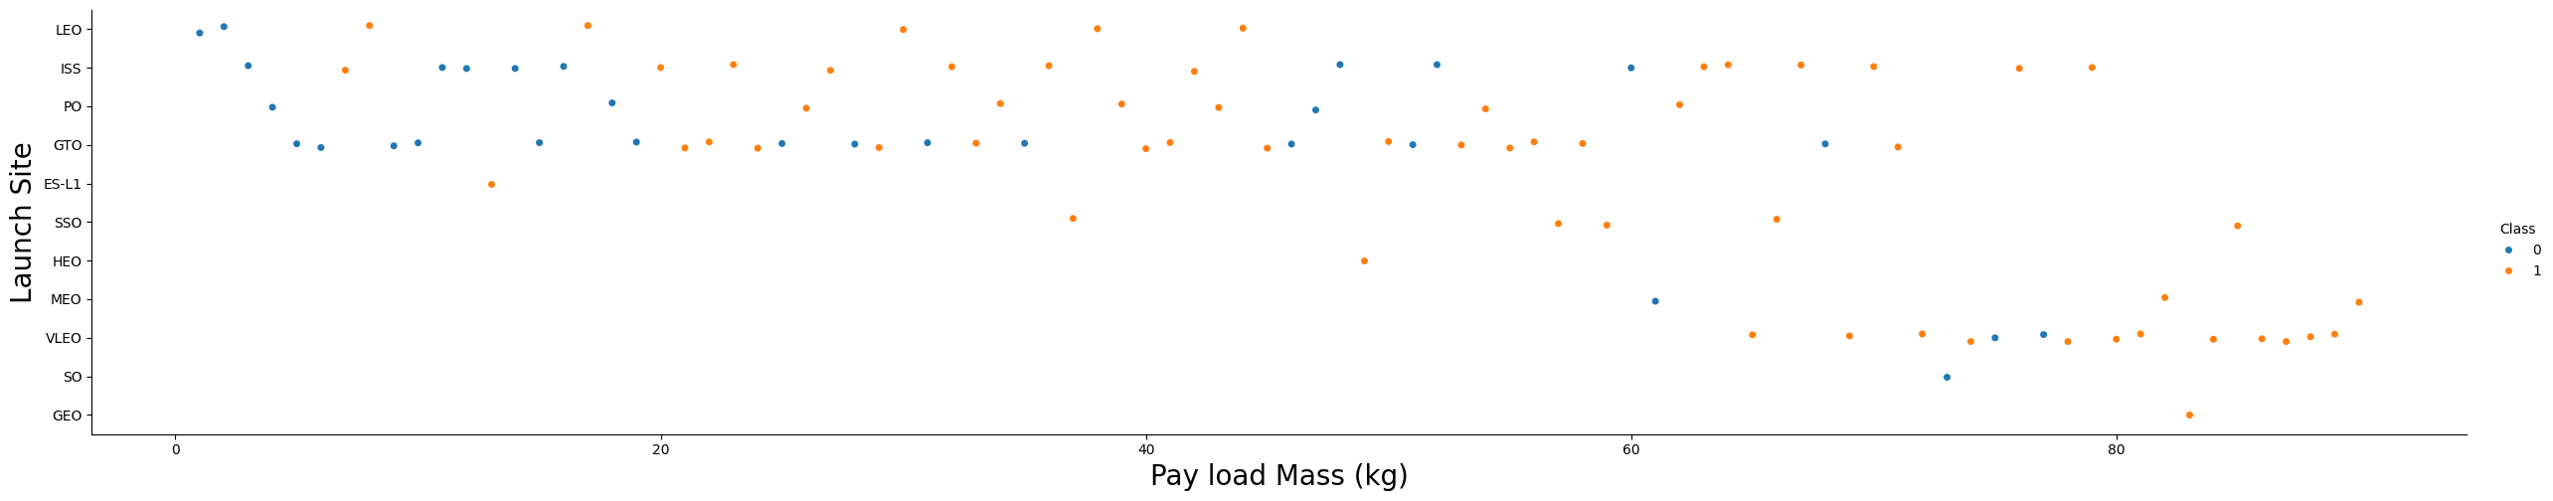
Flight Number vs. Orbit Type
LEO/VLEO/NEO Orbits have a higher success rate with heavier payloads
No such relation exists for GTO/PO, ISS

Slide 22
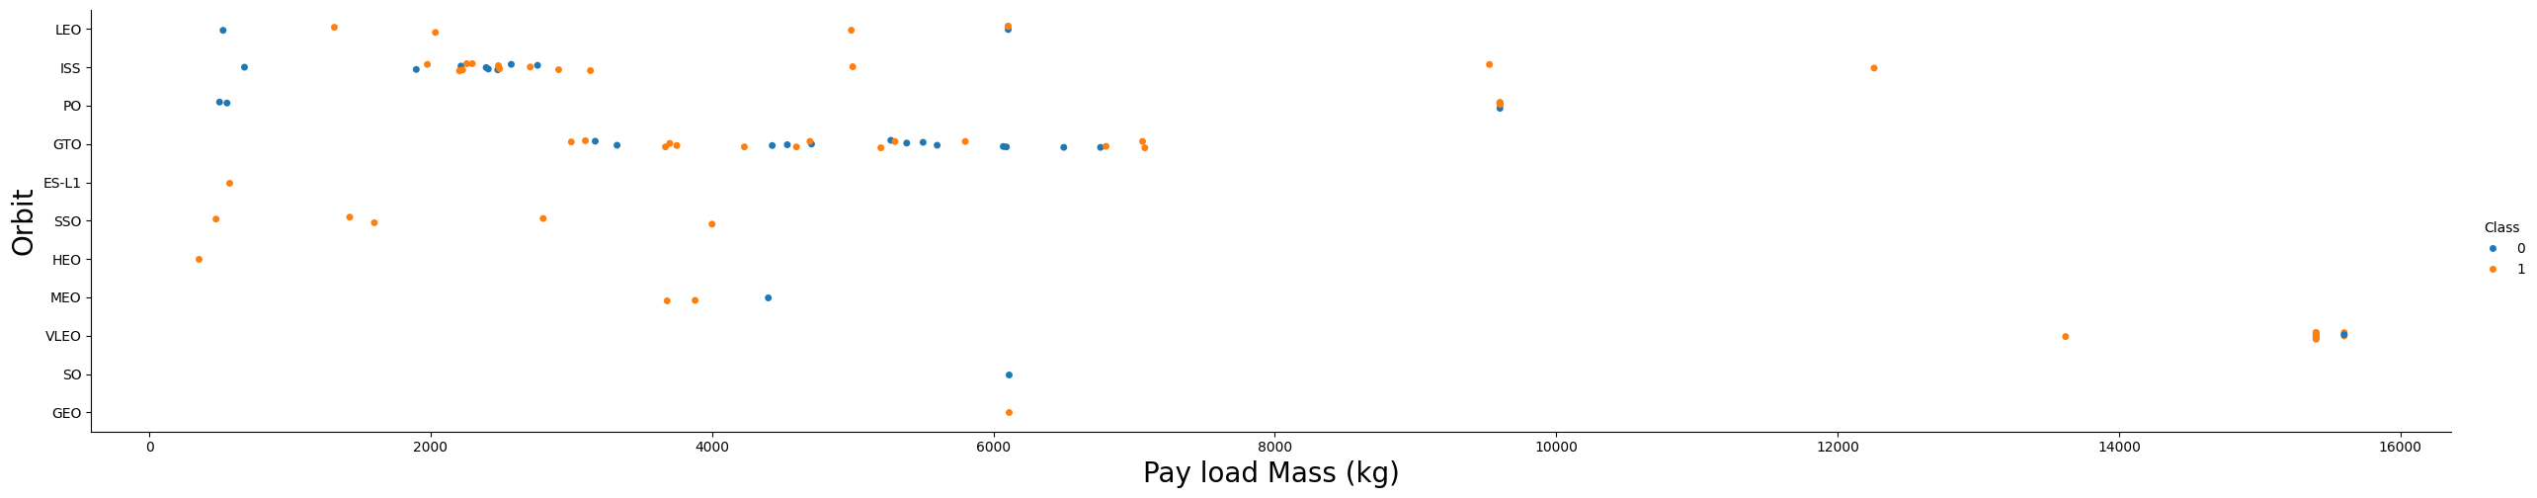
Payload vs. Orbit Type
With heavy payloads the successful landing or positive landing rate are more for Polar,LEO and ISS.
- However for GTO we cannot distinguish this well as both positive landing rate and negative landing(unsuccessful mission) are both there here.

Slide 23
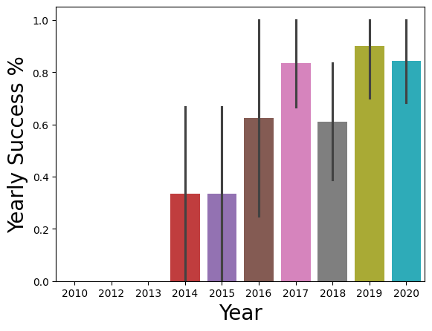
Launch Success Yearly Trend
We can clearly identify that the % increased over years started in 2015, with some failures in 2018, and back over 80% in 2019.

Slide 24
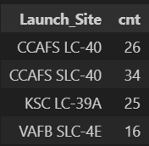
All Launch Site Names
Rockets have been launched for 4 different sites.
The most used being CCAFS SLC 40 with 34 launches,
When VAFB has been used only 16 times.

Slide 25
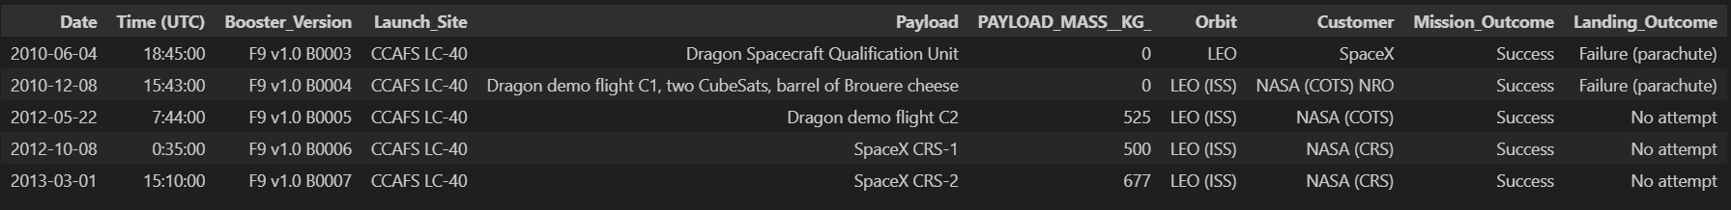
Launch Site Names Begin with 'CCA'
Used early in 2010, with same Booster. Seems to have been used for same LEO Orbit for testing purposes. All mission outcome were a success.

Slide 26
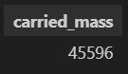
Total Payload Mass
A total of 45.6 Tons have been sent for NASA (CRS)

Slide 27
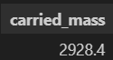
Average Payload Mass by F9 v1.1
An average of 2928Kgs have been carried by booster version F9 v1.1.

Slide 28
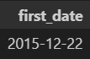
First Successful Ground Landing Date
The first time a rocket has landed on a pad was the 22-12-2015

Slide 29
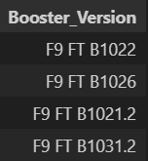
Successful Drone Ship Landing with Payload between 4000 and 6000
4 different boosters have successfully landed on drone ship and had payload mass greater than 4000 but less than 6000

Slide 30
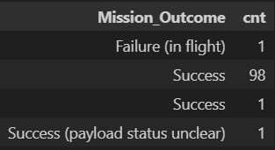
Total Number of Successful and Failure Mission Outcomes
Here’s the total number of successful and failure mission outcomes.
99 were a success, with another one having an unclear payload status, and one failed.

Slide 31
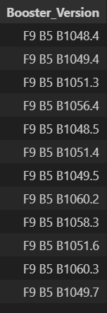
Boosters Carried Maximum Payload
We’ve found this booster list which have carried the maximum payload mass
They all start with “F9 B5”

Slide 32
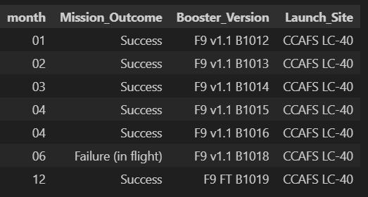
2015 Launch Records
In 2015, a total of 7 missions were launched. One was a failure. Their booster version was different F9 v1,1 or F9 FT. They were all launched from CCAFS LC 40.

Slide 33
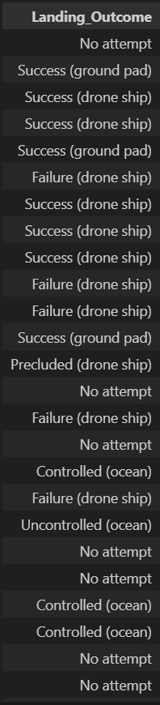
Rank Landing Outcomes Between 2010-06-04 and 2017-03-20
Between 2010-06-04 and 2017-03-20, we can clearly see that the landing outcome improved greatly, starting with No attempt, failure, uncontrolled, and finishing with several successes.

Slide 34

Section 3

Slide 35
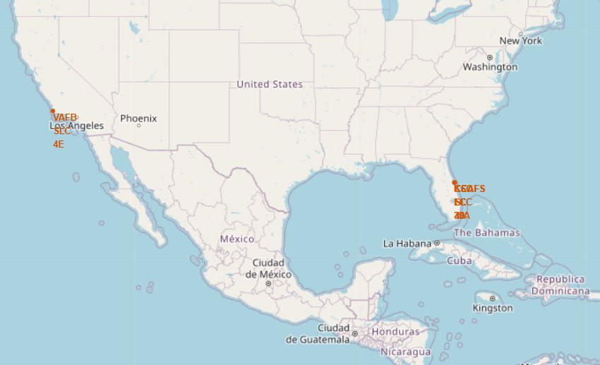
SpaceX Launch Sites
3 launch sites are located on the east coast near Orlando at Cape Canaveral (CCAFS+KSC), and another one on the west coast near Santa Maria (VAFB).
VAFB is the farest from the Equator line. All launch sites are near the coast.

Slide 36
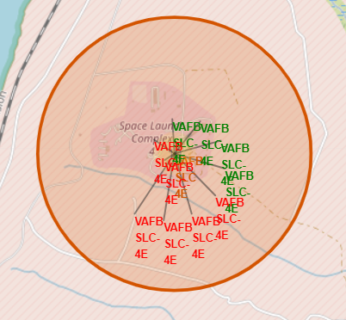
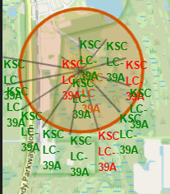
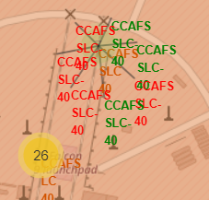
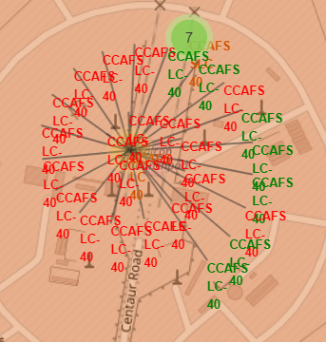
Space X Success rate by launch site
VAFB
KSC
CCAFS SLC
CCAFS LC
In green, mission was a success, in red a failure. We can clearly see that in KSC, most missions were a success compared to VAFB.
CCAFS sites have a lower success rate also.

Slide 37
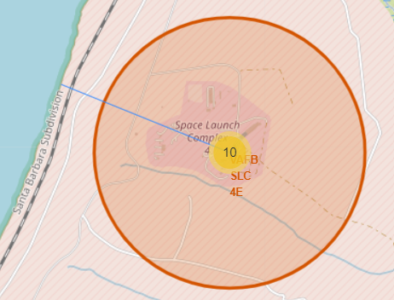
Space X VAFB proximities
From the launchpad, we can clearly see the coast and a railroad.
No highway is present in the vicinity.

Slide 38

Section 4

Slide 39
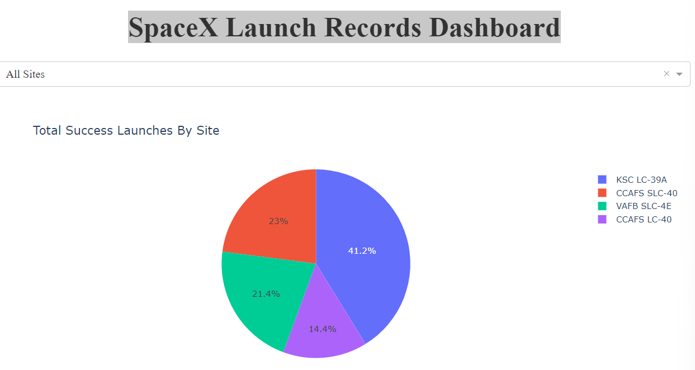
SpaceX Launch Records Dashboard
Looking at the chart, we can clearly identify that KSC is the most successful launch site with 41% of all successes. CCAFS SLC is around 23% only.

Slide 40
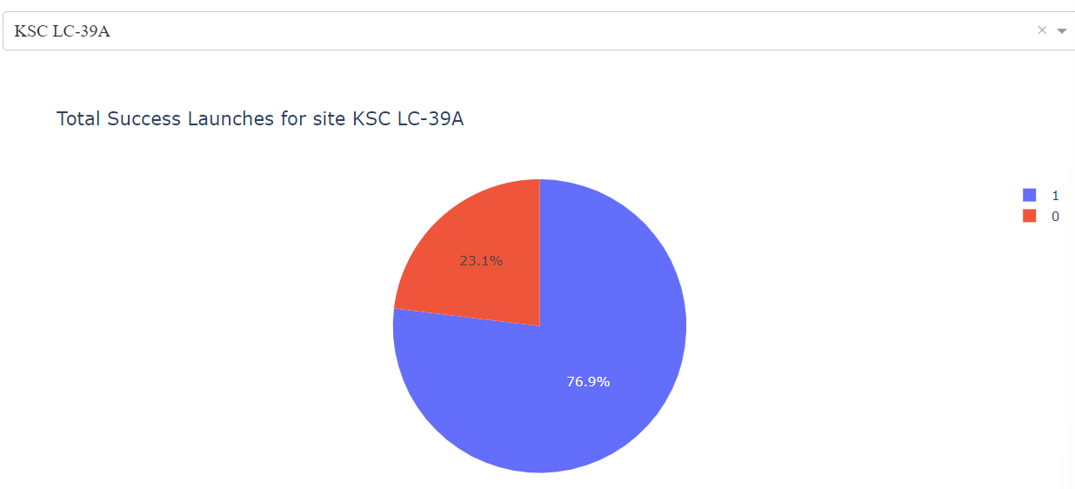
SpaceX KSC LC 39A Success rate
This launch site presents a success rate of 76,9%.

Slide 41
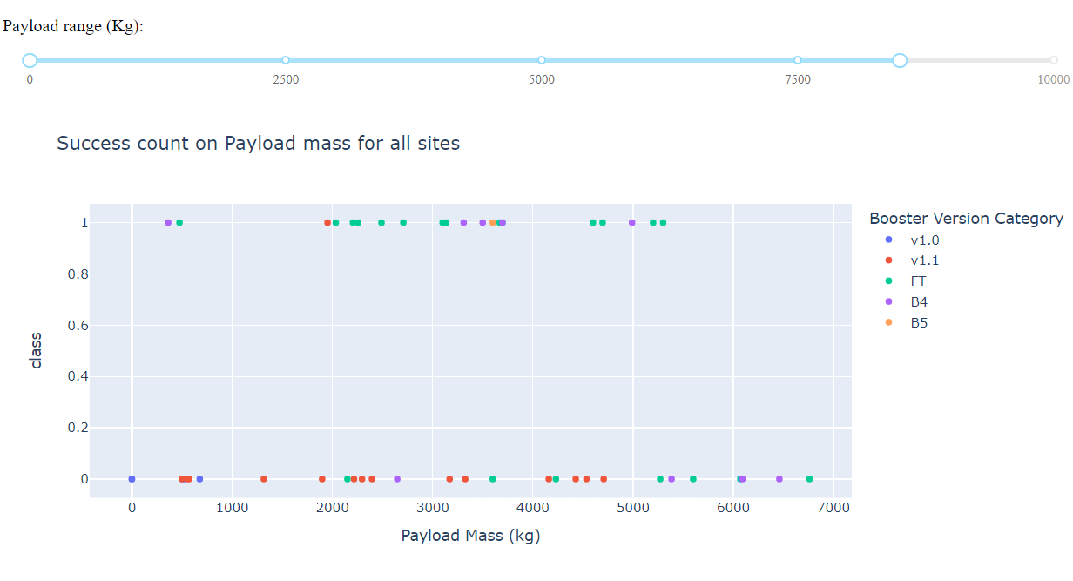
SpaceX Payloads Successes
In Green, the FT Booster shows great results. But it fails over 5500Kgs. Most sucessess are around 2000-3000KGs

Slide 42

Section 5

Slide 43
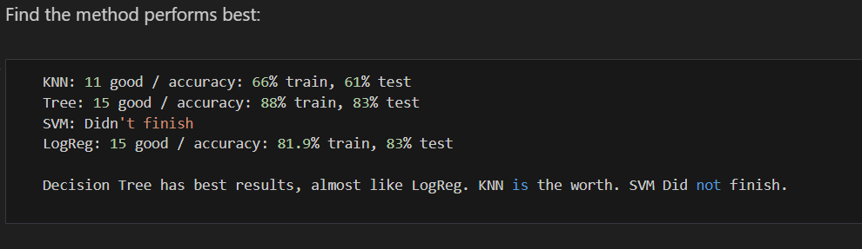
Classification Accuracy
Decision tree has the best results with 88% on the trained model and 83% on test

Slide 44
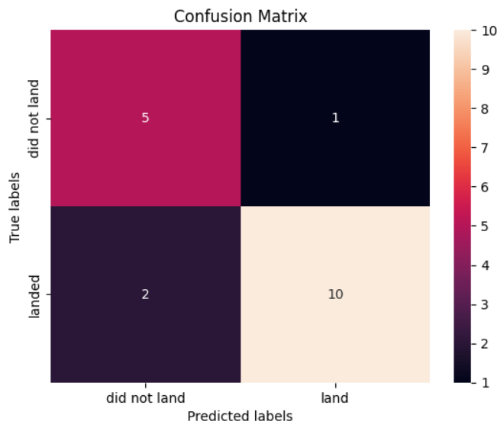
Confusion Matrix
Decision Tree confusion matrix clearly highlight:
15 good results (10 landed + 5 not landed)
2 false negative (did not land vs landed in real)
1 false positive (landed vs did not land in real

Slide 45
Conclusions
It’s better to use KSC as a launch site,
With FT booster and a payload under 5000 KGs
Overall with our decision tree, we can identify with a 83% precision the outcome.

Slide 46
Appendix
Include any relevant assets like Python code snippets, SQL queries, charts, Notebook outputs, or data sets that you may have created during this project
Find everything in the GitHub related repository.

Slide 47


